Slide 1
SQL

Slide 2
Structured Query Language
SQL is a domain-specific language used in programming and designed for managing data held in a relational database management system (RDBMS), or for stream processing in a relational data stream management system (RDSMS). It is particularly useful in handling structured data, i.e. data incorporating relations among entities and variables.

Slide 3
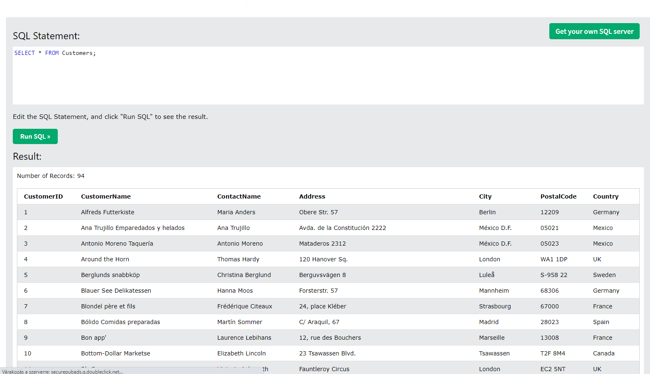
Select *
It returns everything from the database(Select * from Customers)

Slide 4
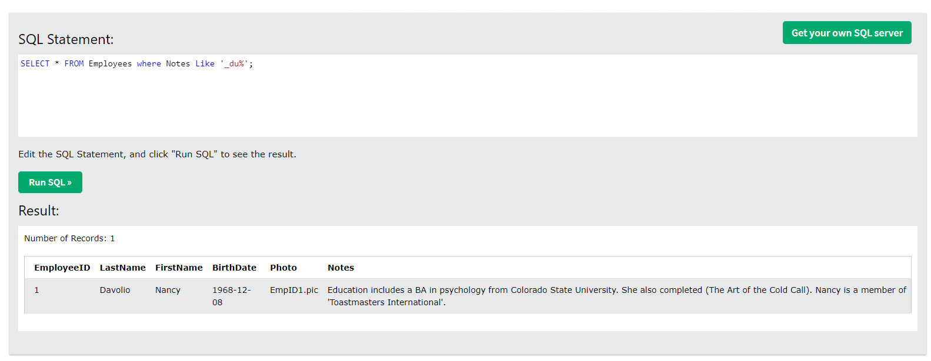
Like
It is used to search for data which contain a specific word or characters
Example(SELECT * FROM Employees where Notes Like '_du%';)
_ : this symbols says that there is one charackter before or after the text or character given by the user
%: this symbol means that there is a unspecified number of character before or after text or character given by the user

Slide 5
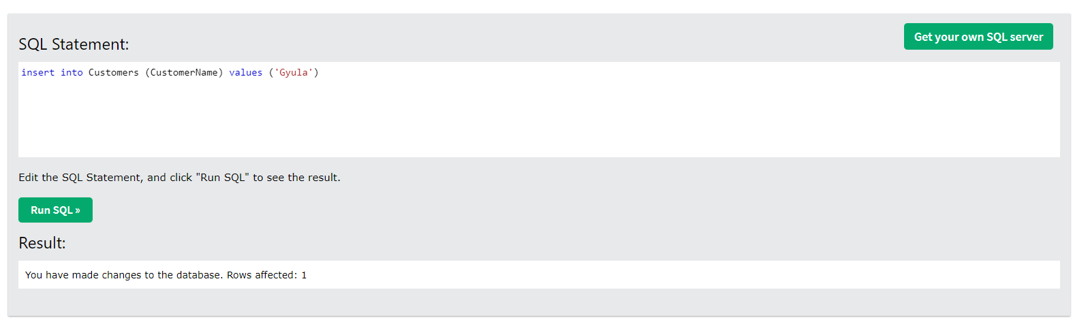
Insert
It adds a new row to the databasewith data you specify
Example (insert into Customers (CustomerName) values ('Gyula'))

Slide 6
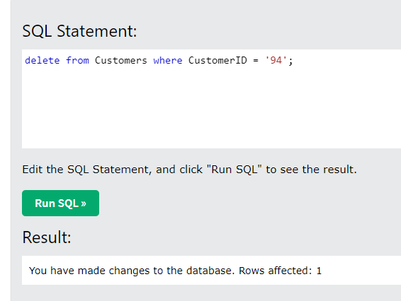
delete
Deletes the data from the database permanently
Example(delete from Customers where CustomerID = '94‚);

Slide 7
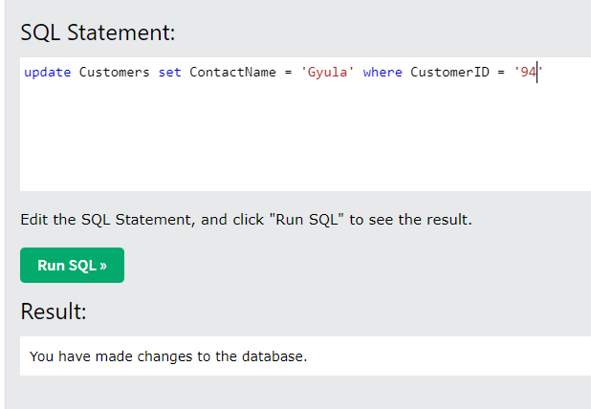
update
Changes the data which you specify int the database
Example(update Customers set ContactName = 'Gyula' where CustomerID = '92‚)

Slide 8
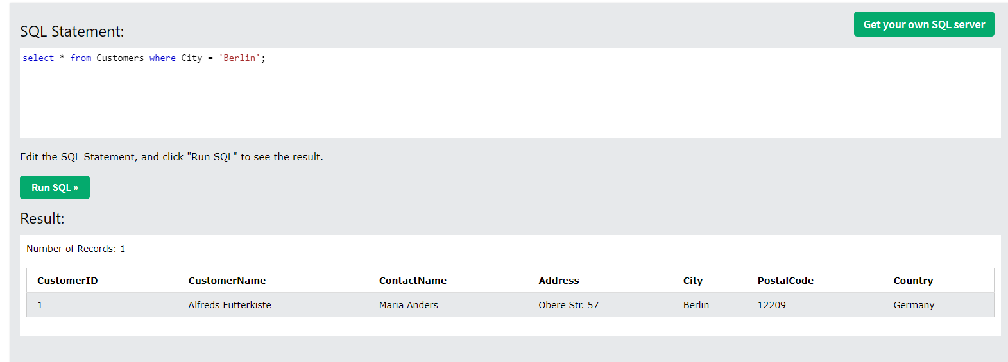
Select if
Returns the data if it fits the condition
Example(select * from Customers where City = 'Berlin';
select * from Customers where City = 'México D.F.' or City = 'Berlin';
select * from Customers where City = 'México D.F.' and ContactName = 'Antonio Moreno';)

Slide 9
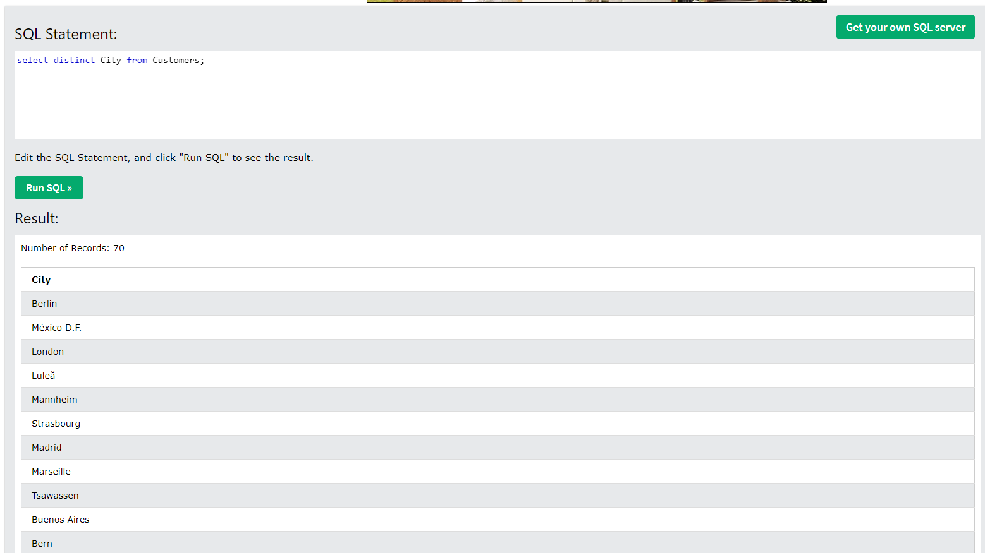
Distinct
It only returns the data once, doesn’t show the duplicates
Example(select distinct City from Customers;)

Slide 10
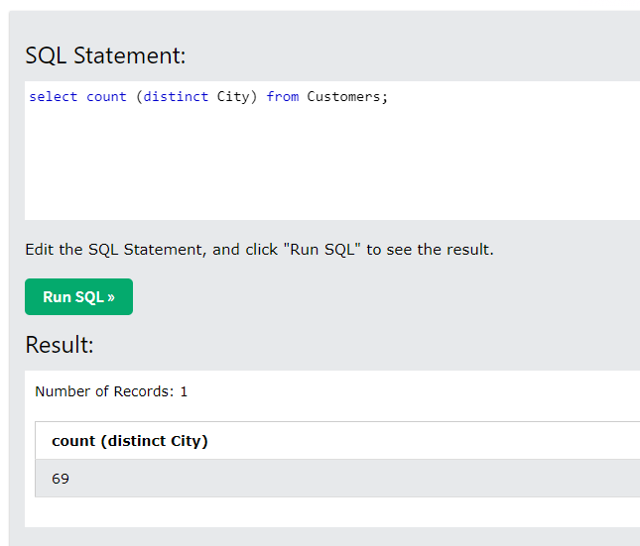
Count
It counts how many data is in a collum
Example(select count City from Customers;)
You can also use distinct here to only count each data once
Example(select count (distinct City) from Customers;)

Slide 11
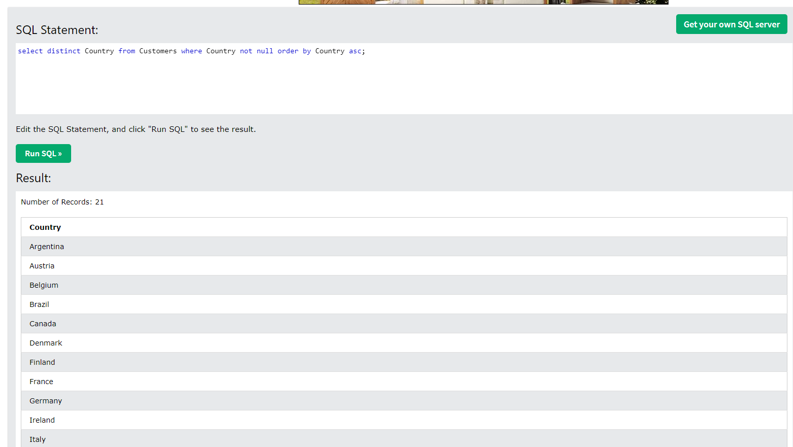
Order by
It makes the data return a specific order
Example(select distinct Country from Customers order by Country;)
You can also make it exclude the ones where the value is null or show onnly the ones with null value and also make them in a ascending or descanding order
Example(select distinct Country from Customers where Country not null order by Country;
select distinct Country from Customers where Country not null order by Country asc;
select distinct Country from Customers where Country not null order by Country desc;
select * from Customers where Country is null;)

Slide 12
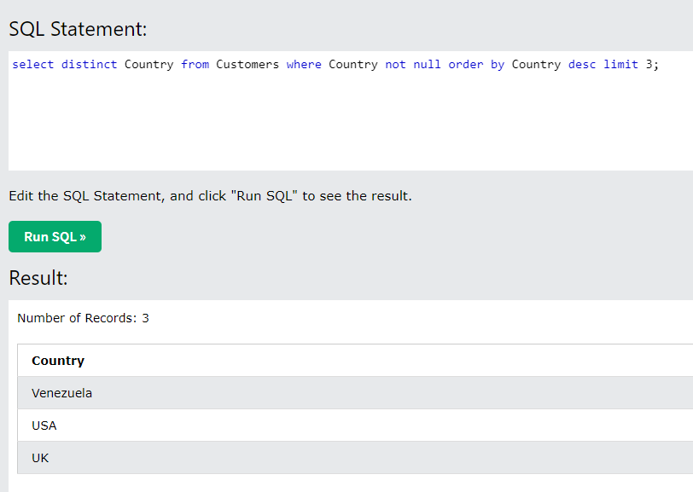
limit
It limits the number of the returned data
Example(select distinct Country from Customers where Country not null order by Country desc limit 3;)

Slide 13
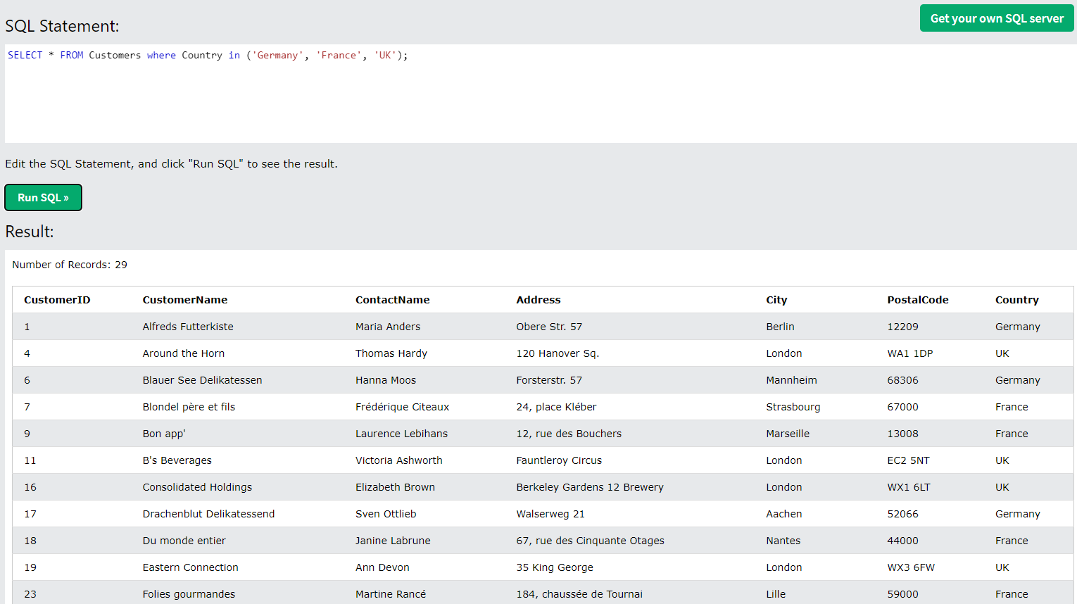
In
It returns data where the values mach
Example(SELECT * FROM Customers where Country in ('Germany', 'France', 'UK');)
You can also say to exclude these values from the returned data
Example(SELECT * FROM Customers where Country not in ('Germany', 'France', 'UK');)

Slide 14
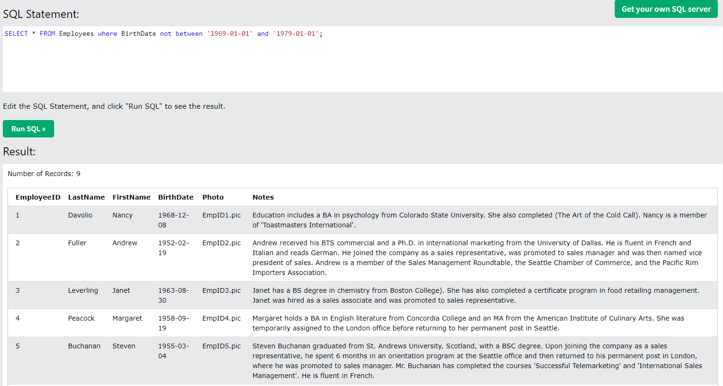
between
It returns data wich are between two given values
Example(SELECT * FROM Employees where BirthDate between '1969-01-01' and '1979-01-01';)
You can also sa to exclude any data which is between the two given values
Example(SELECT * FROM Employees where BirthDate not between '1969-01-01' and '1979-01-01';)

